Slide 1
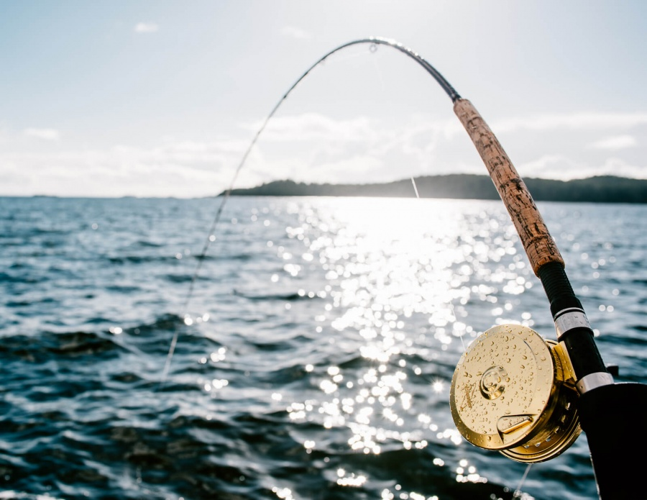
Join us for
The Propeller Club’s
2nd Annual Fishing Tournament
Wednesday, September 18th
Kentmorr Marina
910 Kentmorr Road | Stevensville, MD 21666
Boats leave promptly at 0700 and
return to the dock at 1130
Followed by buffet lunch and awards
$200 per person includes, buffet lunch, beer
and soda on the boats
2 keepers per person
RSVP to Bennett Creighton by August 15th
  Bennett.Creighton@portsamerica.com

